Slide 1
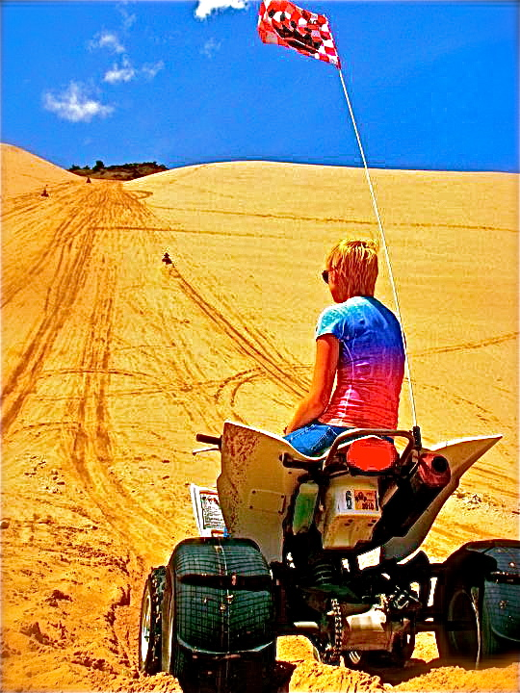
What alli miller lives for!
The Sand Dunes

Slide 2
Presented by
“A Dedicated Sand Lover”
CIS 1020-126 Fall 2010

Slide 3
For
Delan Jensen
Salt Lake Community College

Slide 4
What’s the big deal you ask?
The sand dunes are a place of serenity. To me the sound of engines racing each other gives me a feeling of peace.

Slide 5
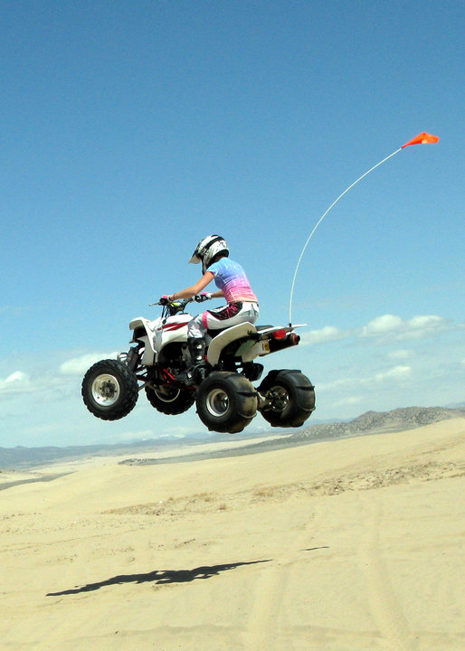

Slide 6
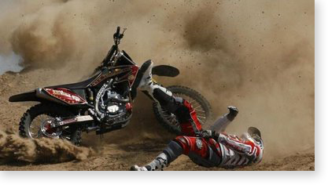

Slide 7
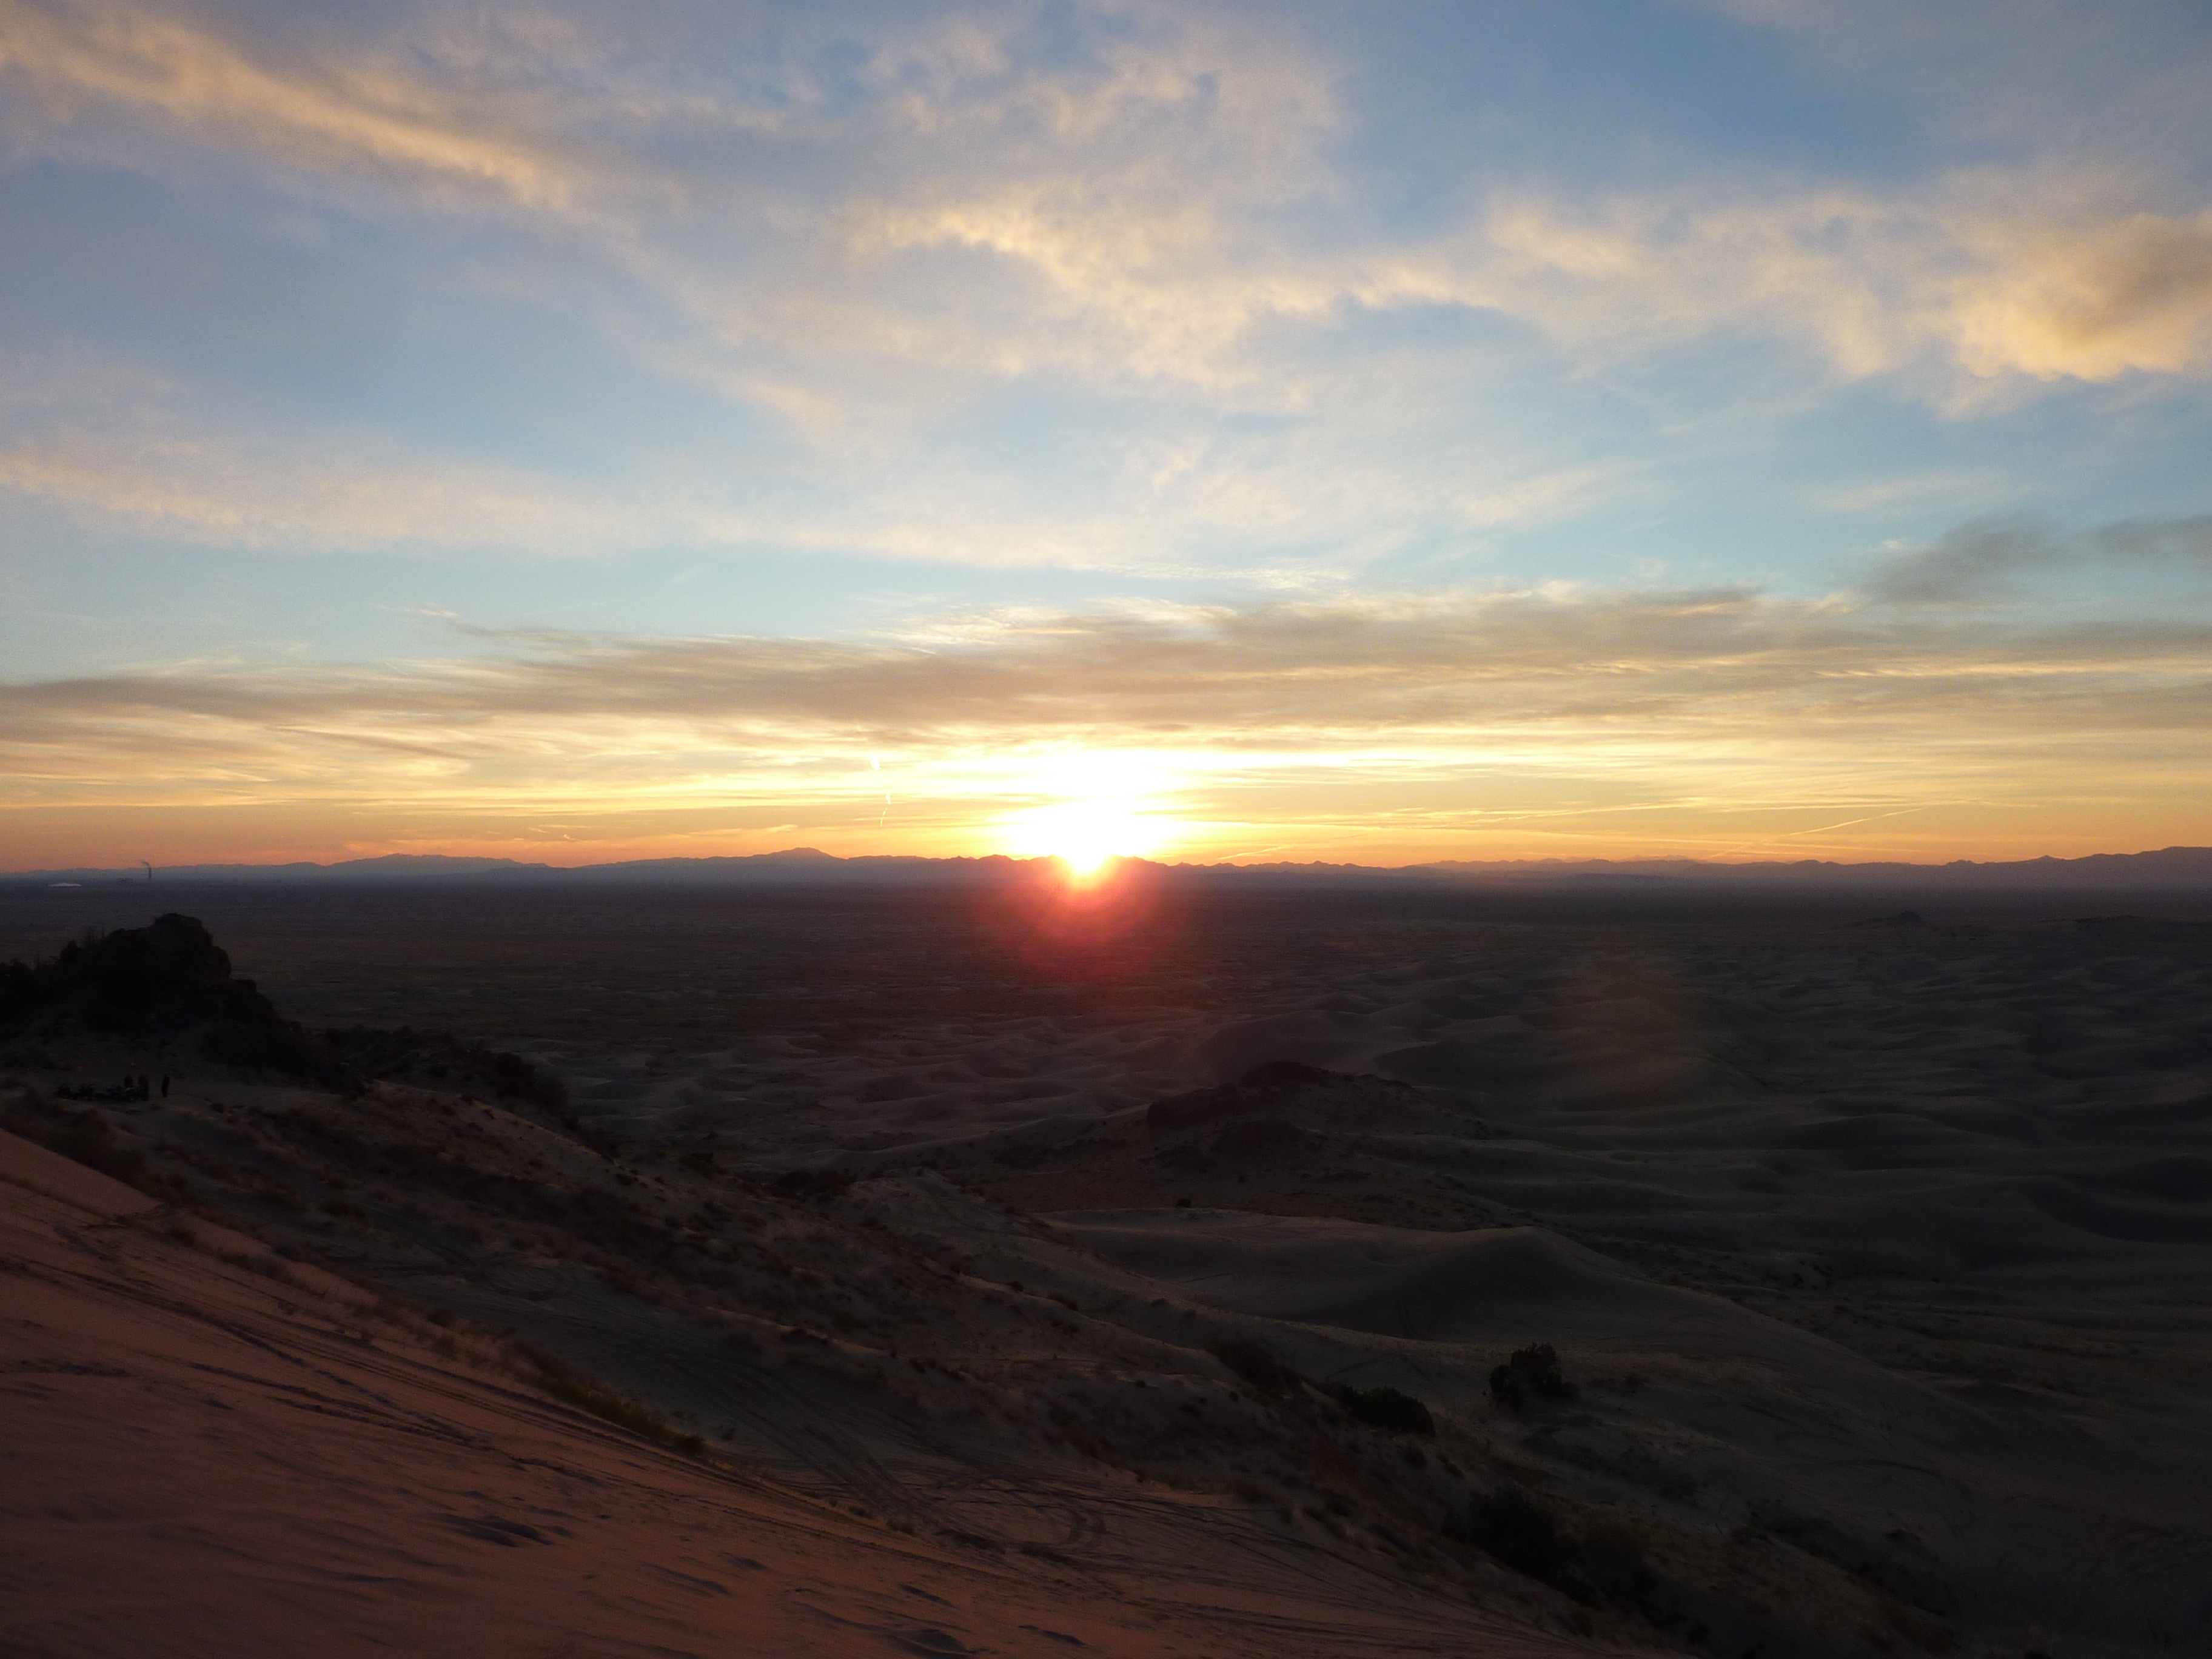
Sunset Point

Slide 8
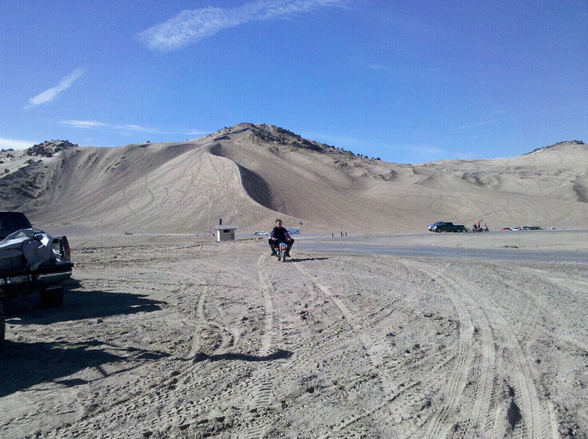
Is Sand Better Than Dirt?
Sand is more forgiving than dirt when you’re body hits it going 20+ MPH.
Dirt is the home to many rocks, making your ride very bumpy.
Although there are many people who enjoy both, I am a dedicated sand rider!

Slide 9
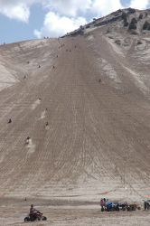
The best time to go to the sand dunes is during the end of spring or the beginning of fall.

Slide 10
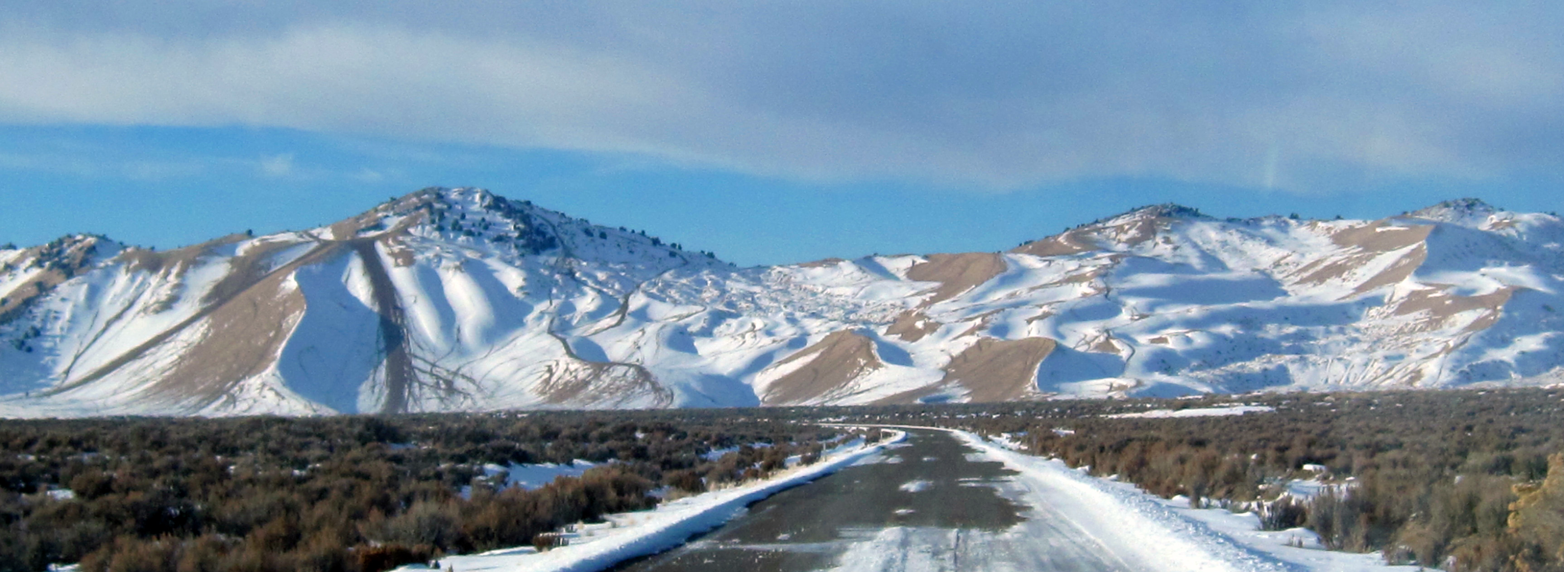
Winter is the most unpleasant time to ride but it’s possible. The freezing temperature is unpleasant but with enough layers it is tolerable.

Slide 11
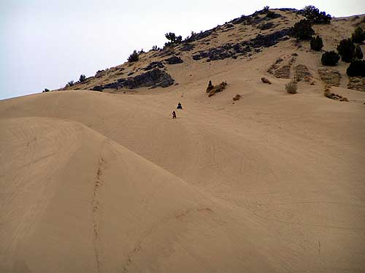
Riding during the middle of summer can be very dangerous unless you are very hydrated and know where to find shade.

Slide 12
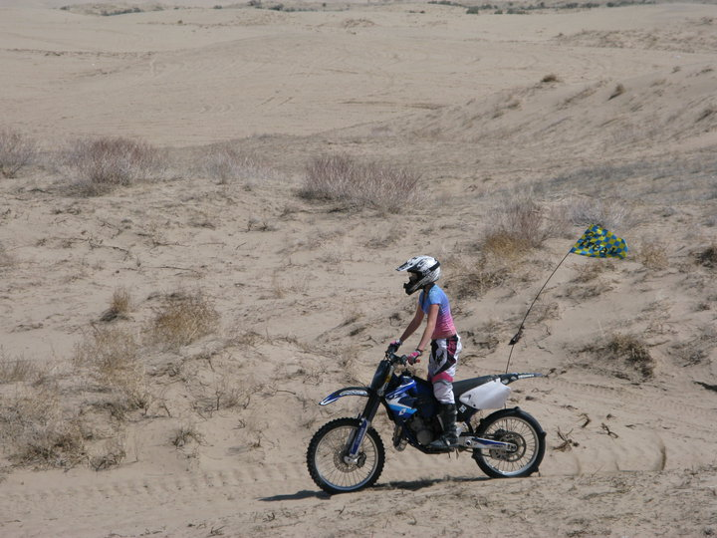
I hope I made it clear why I am such a avid dune rider!
Have a great day!
Thank You For Your Time!

